Slide 1
Priority Queue Scheduling OS161
Tyler Albanese

Slide 2
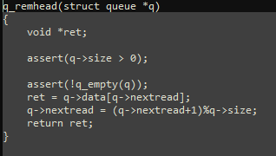
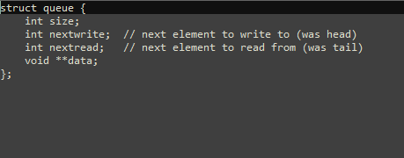
Background
OS161 uses a simple round robin scheduler by default.
Scheduling is based off the queue struct.
Periodically the clock from kern/thread/hardclock.c will cause the scheduler to return the thread in in the ‘nextread’ position (tail).

Slide 3
Background
Dynamic priority queue design
Goal is to assign threads priority based on how interactive they are.
Prioritize threads with more importance to the user (I/O bound threads waiting for user input).
If I/O bound threads don’t consume finish in their time slice they can still be swapped for other threads (just a priority).

Slide 4
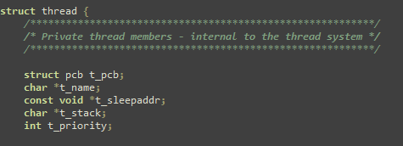
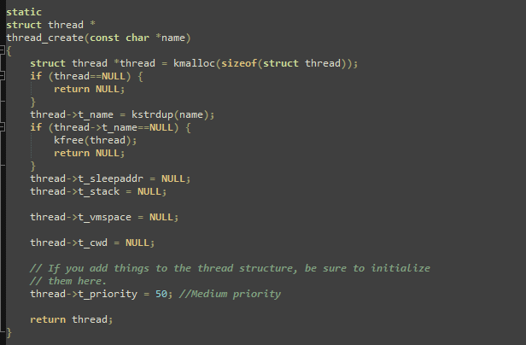
Implementation
How to determine thread priority.
Interactive threads tend to sleep more (waiting for I/O or a mutex etc.).
In OS161 threads can have the states “S_READY” and “S_SLEEP”.
In kern/thread/thread.c we can add a priority field to the thread struct and increment this priority level based on the “nextstate” in the mi_switch function.

Slide 5
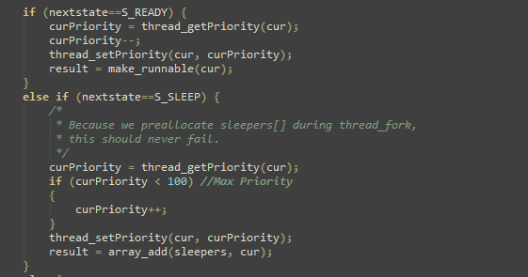
Implementation
Incrementing priority
If “nextstate” is “S_READY” we decrease priority and if “S_SLEEP” we increase.

Slide 6
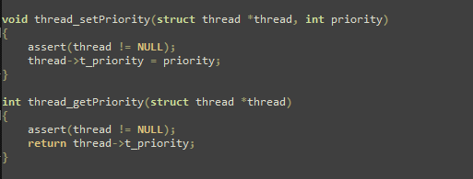
Implementation
Functions for getting and setting priority of thread added to thread.c and thread.h

Slide 7
Implementation
Scheduler
The scheduler structure in kern/thread/scheduler.c implements the scheduling algorithm.
In my implementation I traverse the queue and locate the thread with the highest priority and record its index.
Once I find the highest priority thread I move it to the tail position which will be the thread next scheduled by the scheduler.
This sequence occurs every time the scheduler is called.

Slide 8
Implementation
Queue functions
q_getstart
Returns index of “nextread” (tail);
q_getend
Returns index of “nextwrite” (head);
q_remhead
Returns thread to be at tail and shifts queue
q_getguy
Returns thread at specific index
q_addtail
Places thread at thread at “nextread” (tail) which means it will be scheduled first

Slide 9
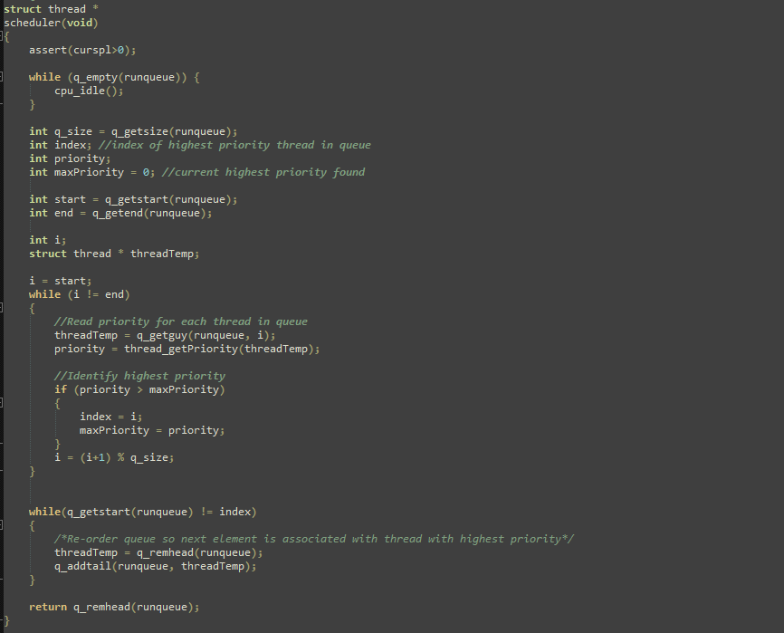
Implementation
Code for scheduler

Slide 10
Conclusions
Testing was difficult because I was unsure how to simulate an I/O bound or frequent sleeping thread.
I was able to compile the kernel with my modifications and run sys161.
The built in thread tests worked successfully other than some interference from my _exit() implementation from lab 4.
Implementing a better scheduling algorithm seemed difficult because of the queue structure rather than a sortable list.
Implementing a more understandable list structure or more queue operation functions for scheduling could make something multi-level scheduling more feasible.
Multi-level scheduling was something I originally considered.

Slide 11
Thank You

